Slide 1
Type Objects
Prof. Dr. Dirk Riehle
Friedrich-Alexander University Erlangen-Nürnberg
ADAP C09
Licensed under CC BY 4.0 International
Notes:
It is Friedrich-Alexander University Erlangen-Nürnberg – FAU, in short.
Corporate identity wants us to say “Friedrich-Alexander University”.

Slide 2
Design-Time vs. Test-Time vs. Run-Time
Developer
Environment
Test
System
Production
System
Design-Time
  Change classes
Test-Time
  Find and file bugs
Run-Time
  Change objects
    Class loading
    Configuration
    Execution
edit
compile
fetch
fetch
build
build
build
deploy
deploy
deploy
test
test
monitor
commit
release
operate

Slide 3
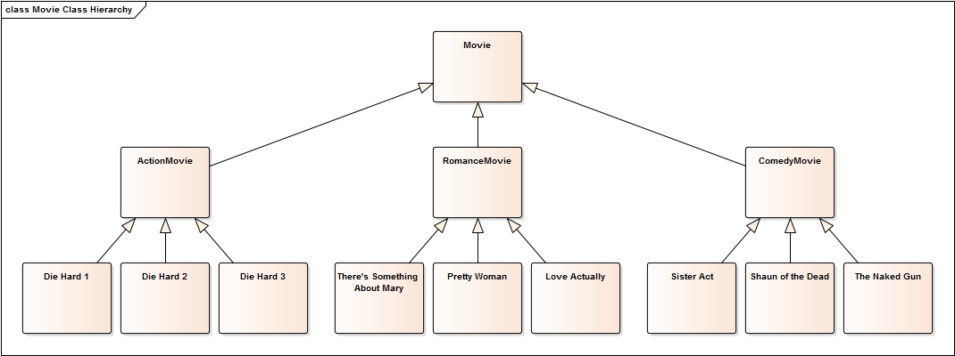
Exploding Class Hierarchies

Slide 4
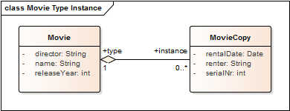
Design-Time / Class Model

Slide 5
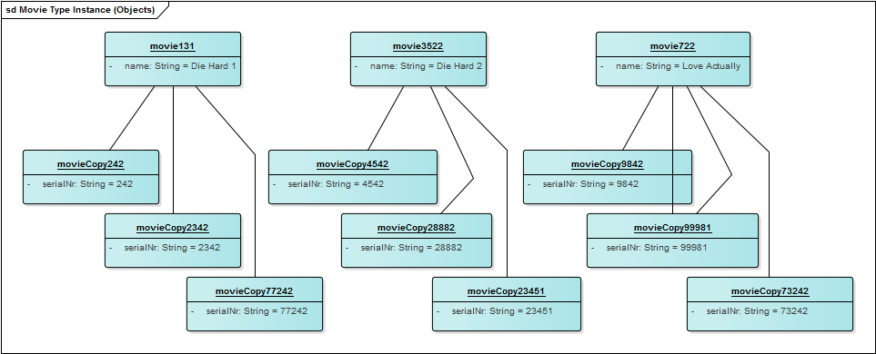
Run-Time / Instances
model (type) level
instance level

Slide 6
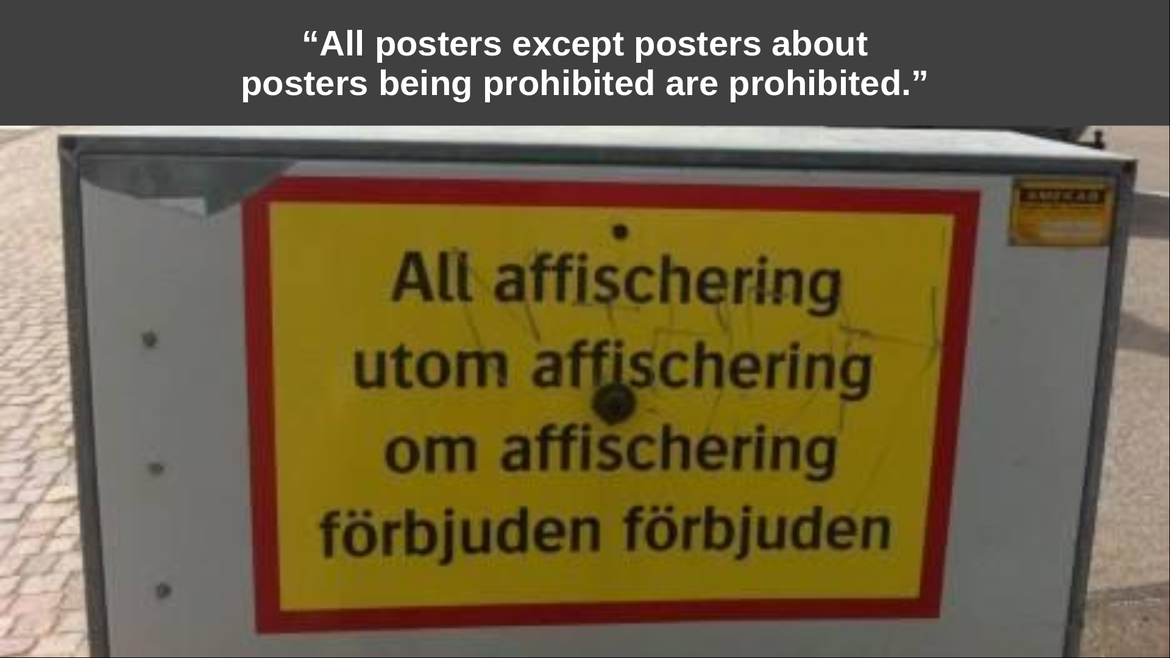

Slide 7
Intent of Type Object Pattern [JW98]
Decouple instances from their classes so that those classes can be implemented as instances of a class. Type Object allows new “classes” to be created dynamically at runtime, lets a system provide its own type-checking rules, and can lead to simpler, smaller systems.

Slide 8
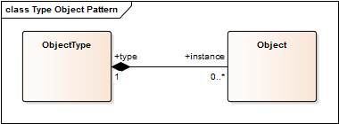
Structure of Type Object Pattern

Slide 9
Collaborations of Type Object Pattern
Object
  Provides instance specific functionality
  Delegates type-specific requests to type object
ObjectType
  Handles type-common requests for instances
  May create and/or manage its instances

Slide 10
Examples of Type Object Pattern
Object and Class
  java.lang.Object: base object class (instances)
  java.lang.Class: Java object type-object-class
Flower and FlowerType
  org.wahlzeit.flowers.Flower: flower object class (instances)
  org.wahlzeit.flowers.FlowerType: flower type-object-class
PersonRole and PersonRoleType
  com.app.model.PersonRole: person-role class
  com.app.model.PersonRoleType: person-role type-object-class

Slide 11
Quiz: Defining Keyboard Models [1]
You are developing software for configuring computers. You are implementing a Keyboard class to represent a keyboard that a customer might choose. However, there are many types of keyboards available and new types keep coming up.
Using the Type Object pattern, how would you design the Keyboard class to make it easy to introduce new keyboard types later on?
Select all correct statements.
  The Keyboard class defines two string attributes, model and make.
  A separate KeyboardType class defines two attributes, model and make.
  The Keyboard class defines a reference to a KeyboardType class.
  A KeyboardType class defines a collection references to Keyboard objects.
[1] Model and make are (common) synonyms for types.

Slide 12
Answer: Defining Keyboard Models
Using the Type Object pattern, how would you design the Keyboard class to make it easy to introduce new keyboard types later on?
  The Keyboard class defines two string attributes, model and make.
    No. This type information belongs into a Type Object class.
  A separate KeyboardType class defines two attributes, model and make.
    Yes: You need a KeyboardType class to collect type information.
    Maybe: Model and make are reasonable attributes of KeyboardType.
  The Keyboard class defines a reference to a KeyboardType class.
    Yes. A Keyboard object needs to access a KeyboardType object.
    A direct reference is the easiest way to access the object.
  A KeyboardType class defines a collection references to Keyboard objects.
    No. It is unusual to make the type object track its instances.
    If anything, you’ll use a Manager object for this task.

Slide 13
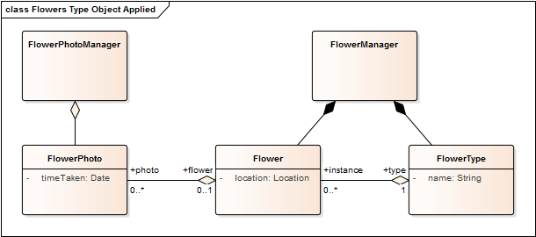
Type Object Applied to Flowers

Slide 14
Creating Flower Instances
public Flower FlowerManager#createFlower(String typeName) {
assertIsValidFlowerTypeName(typeName);
FlowerType ft = getFlowerType(typeName);
Flower result = ft.createInstance(...);
flowers.put(result.getId(), result);
return result;
}
public Flower FlowerType#createInstance() {
return new Flower(this);
}
protected FlowerType Flower#flowerType = null;
public Flower#Flower(FlowerType ft) {
flowerType = ft;
}

Slide 15
Benefits of Type Object Pattern
Reduces an exploding class hierarchy to two classes
Allows for managing new classes (types) are runtime

Slide 16
Downsides of Type Object Pattern
Increased run-time complexity
  Makes code more difficult to read
  Makes debugging more difficult

Slide 17

Quiz: Type Object Hierarchy
Plants are classified (in a hierarchy) according to the International Code of Nomenclature for Cultivated Plants.
How to represent a type hierarchy for flowers in Flowers?
Flower families photo courtesy of Wikipedia

Slide 18
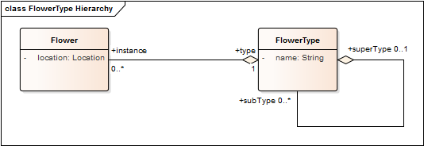
Answer 1 / 2: Type Object Hierarchy

Slide 19
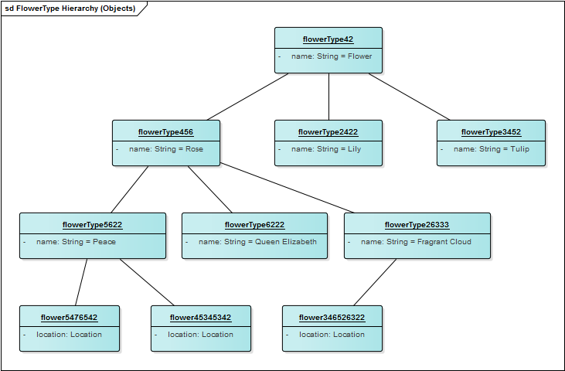
Answer 2 / 2: Type Object Hierarchy
model (type) level
instance level

Slide 20
Implementing the FlowerType Hierarchy
public class FlowerType extends DataObject {
protected FlowerType superType = null;
protected Set<FlowerType> subTypes = new HashSet<FlowerType>();
public FlowerType getSuperType() {
return superType;
}
public Iterator<FlowerType> getSubTypeIterator() {
return subTypes.iterator();
}
public void addSubType(FlowerType ft) {
assert (ft != null) : “tried to set null sub-type”;
ft.setSuperType(this);
subTypes.add(ft);
}
...
}

Slide 21
Using a FlowerType Object
public class FlowerType {
public boolean hasInstance(Flower flower) {
assert (flower != null) : “asked about null object”;
if (flower.getType() == this) {
return true;
}
for (FlowerType type : subTypes) {
if (type.hasInstance(flower)) {
return true;
}
}
return false;
}
...
}

Slide 22
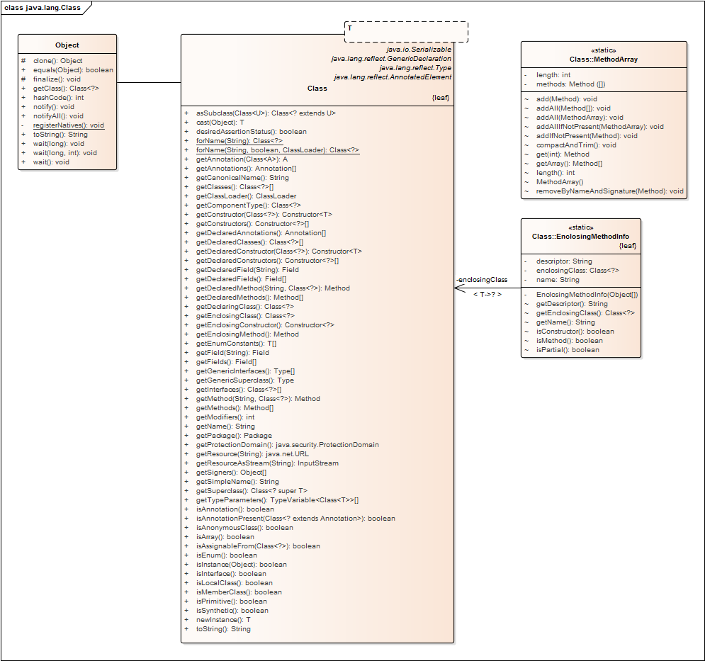

Slide 23
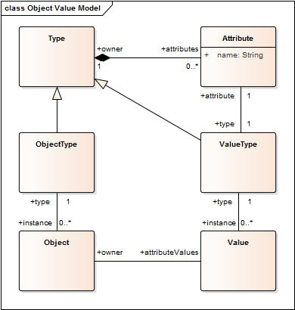
Simple Object Value Model
model (type) level
instance level

Slide 24
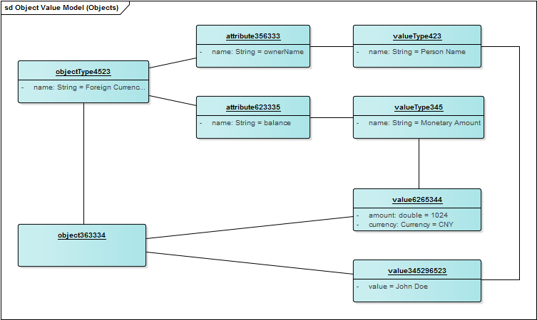
Example of Simple Object Value Model
model (type) level
instance level

Slide 25
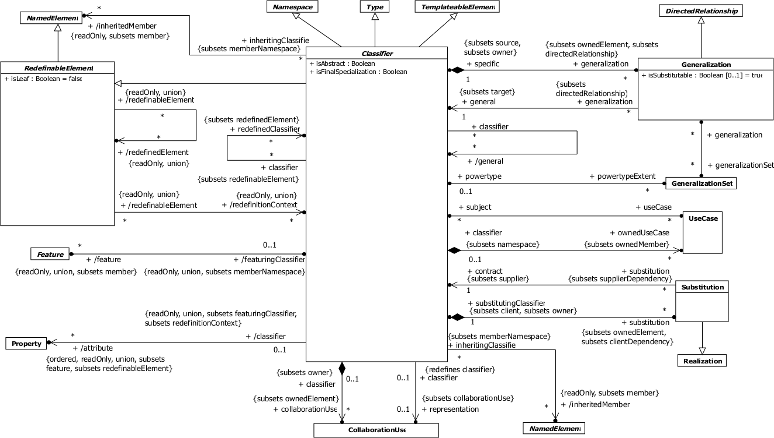
The Classifier Part of the UML Metamodel

Slide 26
Java, UML, Flowers
M2 Language Level | M1 Model / Code Level | M0 Run-time / Obj. Level
java.lang.Class ... | java.lang.Object flowers.FlowerPhoto flowers.FlowerType flowers.Flower ... | fragrantCloud : FlowerType flower34563 : Flower ...
uml.Classifier uml.Generalization uml.StereoType uml.Component ... | flowers.FlowerPhoto flowers.FlowerType flowers.Flower ... | fragrantCloud : FlowerType flower34563 : Flower ...
flowers.FlowerType ... | flowers.Flower : FlowerType fragrantCloud : FlowerType ... | flower34563 : Flower ...

Slide 27
Model / Instance Relationships (Static)
M2 Language Level | M1 Model / Code Level | M0 Run-time / Obj. Level
java.lang.Class ... | java.lang.Object flowers.FlowerPhoto flowers.FlowerType flowers.Flower ... | fragrantCloud : FlowerType flower34563 : Flower ...
uml.Classifier uml.Generalization uml.StereoType uml.Component ... | flowers.FlowerPhoto flowers.FlowerType flowers.Flower ... | fragrantCloud : FlowerType flower34563 : Flower ...
flowers.FlowerType ... | flowers.Flower : FlowerType fragrantCloud : FlowerType ... | flower34563 : Flower ...
static model / instance relationships

Slide 28
Model / Instance Relationships (Dynamic)
M2 Language Level | M1 Model / Code Level | M0 Run-time / Obj. Level
java.lang.Class ... | java.lang.Object flowers.FlowerPhoto flowers.FlowerType flowers.Flower ... | fragrantCloud : FlowerType flower34563 : Flower ...
uml.Classifier uml.Generalization uml.StereoType uml.Component ... | flowers.FlowerPhoto flowers.FlowerType flowers.Flower ... | fragrantCloud : FlowerType flower34563 : Flower ...
flowers.FlowerType ... | flowers.Flower : FlowerType fragrantCloud : FlowerType ... | flower34563 : Flower ...
dynamic model / instance
relationships

Slide 29
Vocabulary
Metaclass, class and object
  Usually used in absolute terms, covering levels M2, M1, M0
    Metaclass = element of M2 level (language level)
    Class = element of M1 level (model level)
    Object = element of M0 level (object/instance/run-time level)
Meta-object and base-object
  Usually use as relative terms: the meta-object describes the base-object
    A meta-object can be the base-object for another meta-object
Type and instance
  Usually used as relative terms, similary to meta and base-object

Slide 30
Meta-Object Protocols (MOPs)
Introspection
  Provide information about base objects
Intercession
  Manipulate structure and behavior of base objects

Slide 31
Review / Summary of Session
Type object design pattern
  Definition, purpose, examples
  In application domains (movies, flowers)
  In technical domains (object/class, UML)
Meta-modeling
  UML metamodel
  Static and dynamic relationships

Slide 32
Thank you! Questions?
dirk.riehle@fau.de – http://osr.cs.fau.de
dirk@riehle.org – http://dirkriehle.com – @dirkriehle
DR

Slide 33
Credits and License
Original version
  © 2012-2019 Dirk Riehle, some rights reserved
  Licensed under Creative Commons Attribution 4.0 International License
Contributions
  ...

